Slide 1
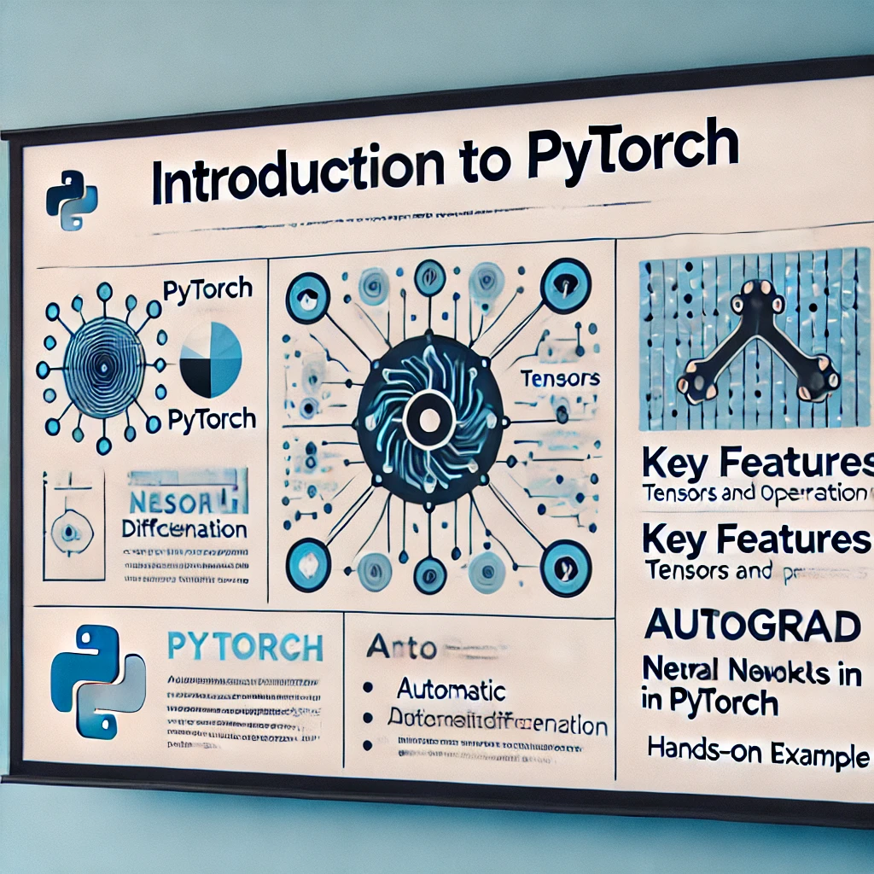
Introduction to PyTorch
Instructor: Stephin Rachel Thomas
June 17, 2025

Slide 2
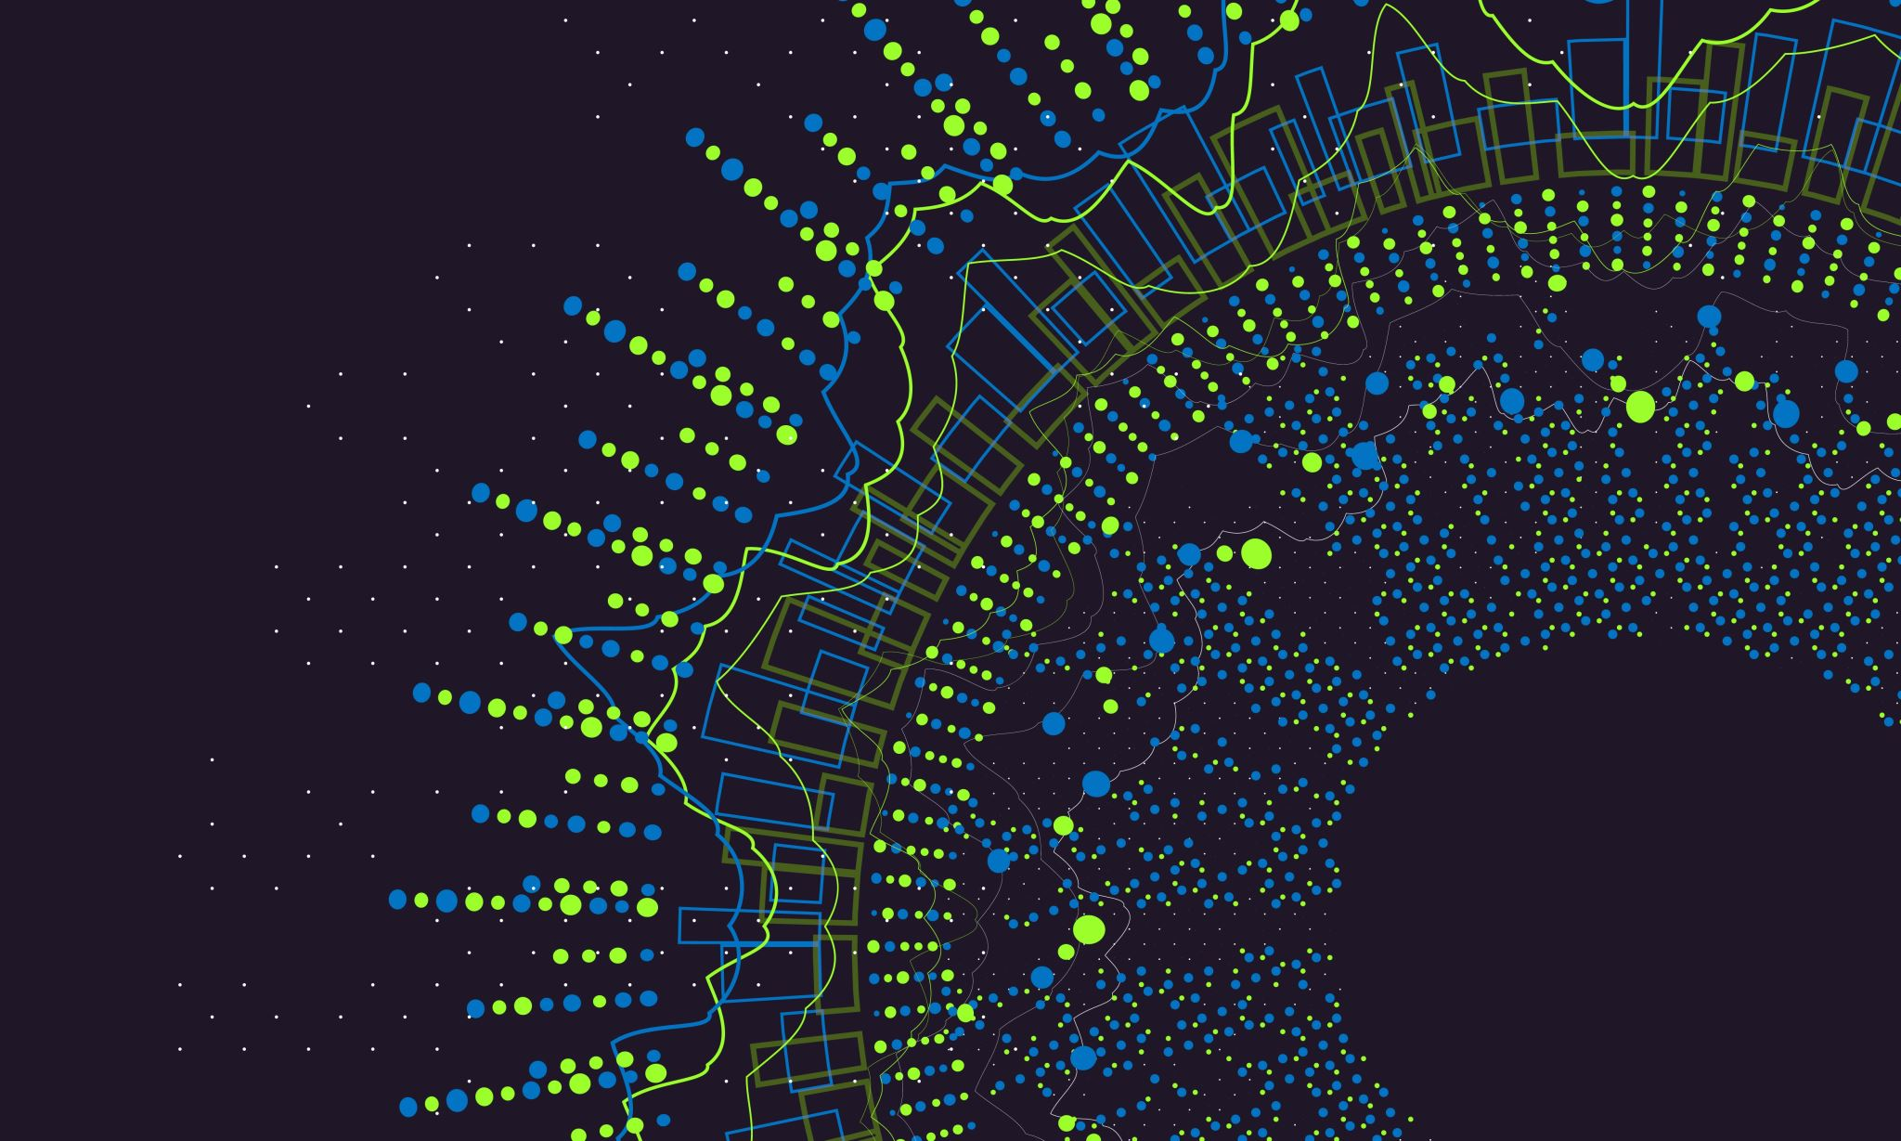
Today’s Topics
What is PyTorch
History of PyTorch
Key Features
PyTorch Vs Tensorflow
Core components of PyTorch
Deep dive into tensors
Neural Network Module
Optimizers and Loss Function
Data Handling in PyTorch
CV with PyTorch
Advanced Features
Community and Ecosystem
Best Practices in PyTorch

Slide 3

What is PyTorch?
PyTorch is an open-source machine learning library for Python, known for its flexibility, ease of use, and dynamic computation graph.
It allows researchers to experiment quickly with deep neural networks, and it's extensively used in academia and industry for applications ranging from computer vision to natural language processing.
PyTorch is one of the most popular deep learning frameworks that allows us to implement neural network more efficiently.

Slide 4
History of PyTorch
Early Beginnings (Torch) - 2002
PyTorch evolved from Torch, a machine learning framework built on Lua in 2002.
Torch gained popularity for its GPU acceleration and was widely used in academia.
However, Lua was not as popular as Python, limiting Torch’s adoption.
Birth of PyTorch - 2016
Facebook’s AI Research Lab (FAIR) developed PyTorch to provide a Pythonic alternative to Torch.
Released in October 2016, PyTorch introduced dynamic computation graphs and easy debugging, making it popular among researchers
Growth and Adoption (2017-2020)
Quickly became the preferred framework for AI research, deep learning, and NLP.
Hugging Face adopted PyTorch for transformers and NLP models.
Facebook introduced TorchScript for model deployment.
Competition with TensorFlow (2021- Present)
By 2021, PyTorch had surpassed TensorFlow in research usage.
PyTorch 2.0 (2023) introduced faster performance with torch.compile.
In September 2022, PyTorch transitioned to the Linux Foundation, ensuring open governance.
Today, it’s widely used in academia, industry, and production AI models.

Slide 5
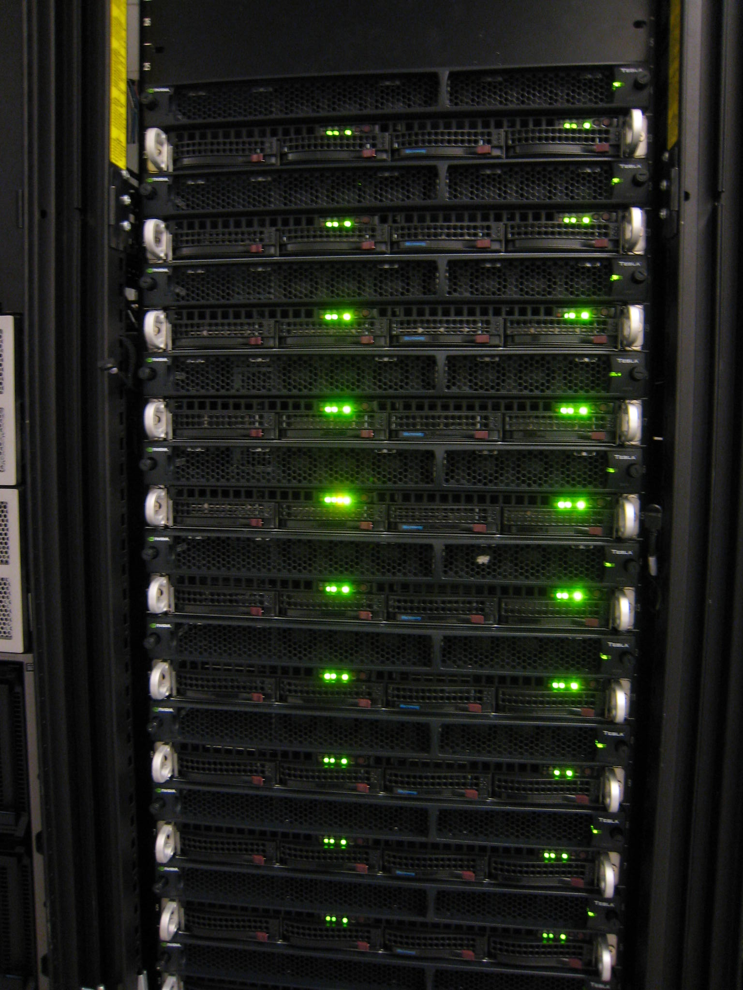
Key Features of PyTorch
PyTorch's key features include its dynamic computation graph (which allows changes to the network on the fly), strong GPU acceleration for faster computations, and its deep integration with the Python programming language. This integration makes PyTorch not only powerful but also flexible and intuitive, offering seamless compatibility with popular Python libraries like NumPy and SciPy.

Slide 6
PyTorch
Facilitates building deep learning projects
Easily run array-based calculations
Build dynamic neural networks
Perform auto differentiation with a strong GPU acceleration
Developed to process large-scale image analysis
Object detection
Segmentation
Classification
Supported by all major cloud platforms
Amazon Web Services
Google Cloud Platform
Microsoft Azure
Supports CPU, GPU, TPU and parallel processing

Slide 7
PyTorch vs. Tensorflow
Feature/Aspect | PyTorch | TensorFlow
Primary Language | Python | Python, with APIs in other languages
Computation Graphs | Dynamic (Define-by-Run) | Static (Define-and-Run)
Ease of Use | Generally considered more user-friendly and intuitive | Steeper learning curve, improved with Keras
Debugging | Easier due to dynamic graphs and Pythonic nature | More complex, requires separate tools
Performance | Comparable, with slight variations based on use case | Comparable, with optimizations for large-scale
Community & Support | Strong community, especially in research | Strong community, less popular in research
Deployment | Growing in mobile and web deployment | Extensive deployment options, including TFLite
Pre-Trained Models | Available through TorchVision, etc. | Extensive range in TensorFlow Hub
Distributed Training | Supported with PyTorch Distributed | Advanced options with TensorFlow Distributed
Integration | Seamless with Python libraries | Integrates well with TensorFlow ecosystem
Use PyTorch if: You are a beginner, doing research, or need flexibility (e.g.NLP, CV).
Use TensorFlow if: You need enterprise-level solutions, mobile deployment, or production-ready models.

Slide 8
Core Components of PyTorch
PyTorch comprises several core components:
Tensors, which are similar to NumPy arrays but with GPU support
Autograd, for automatic differentiation
Optimizers, which abstract the optimization algorithms used to train neural networks.
These components work together to simplify the process of creating and training complex models.

Slide 9
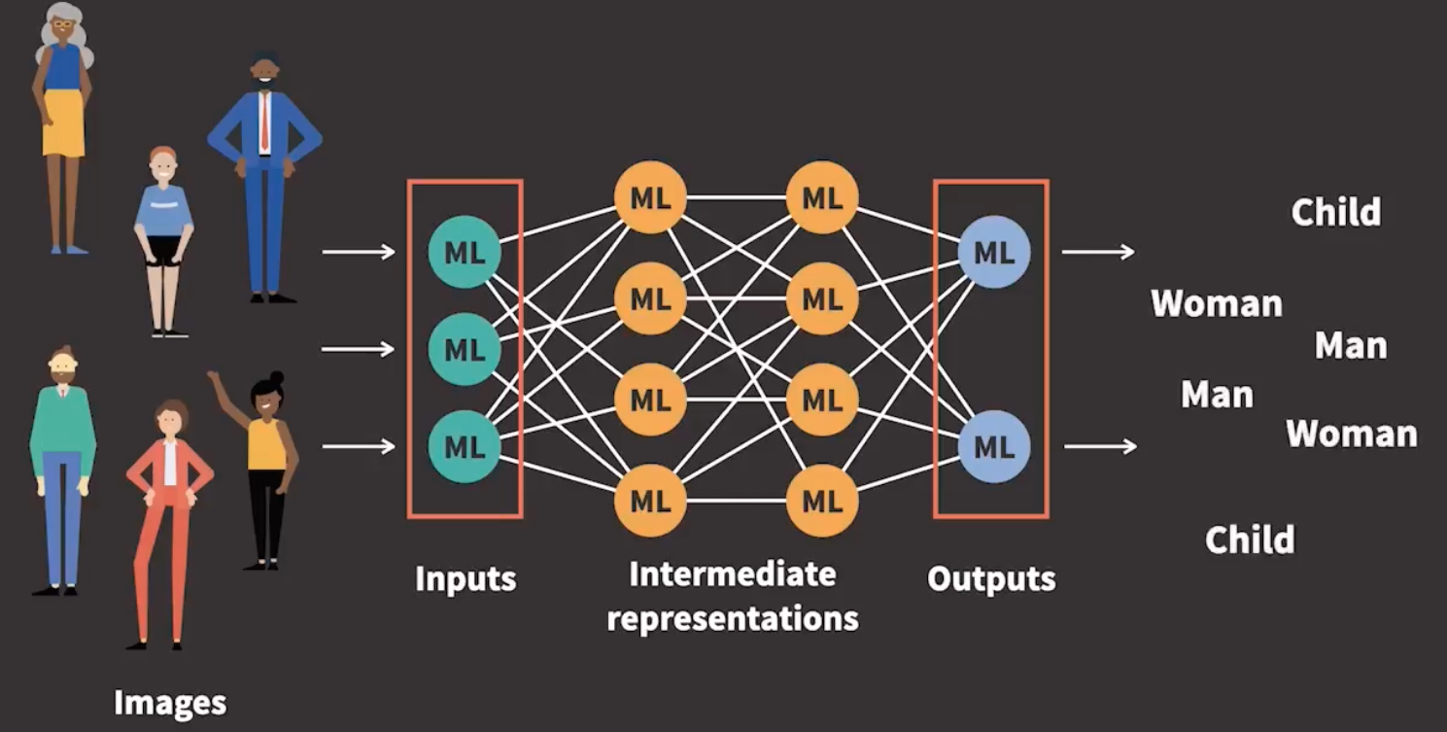
Deep Dive into Tensors
Tensors are the fundamental building blocks in PyTorch, representing data like images or text.
To handle and store the data in all stages of deep learning, PyTorch uses this essential data structure called tensor.
Inputs, intermediate representations and outputs are stored as tensors.

Slide 10
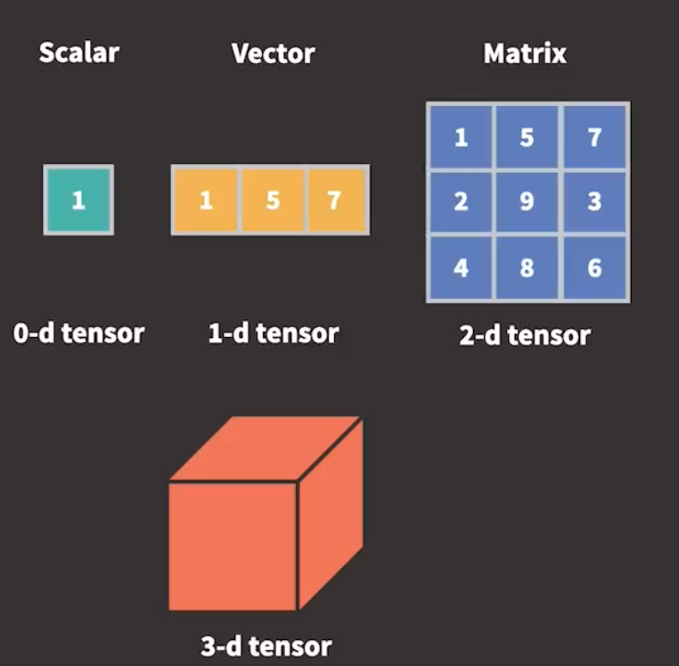
Deep Dive into Tensors
In mathematics, tensors can be defined as generalization of scalars, vectors and matrices to any dimension
In PyTorch, Tensors are multidimensional array containing elements of a single data type
Tensor is similar to fundamental object in NumPy called ndarray
ndarray is defined as n-dimensional homogeneous array of fixed-sized items

Slide 11
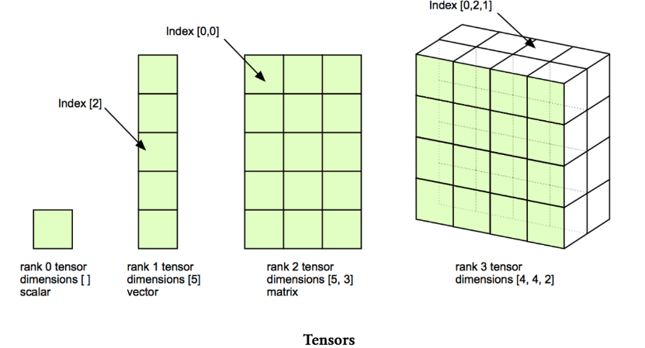
Deep Dive into Tensors
Tensor operations are performed significantly faster using GPUs
Tensors can be stored and manipulated at scale using distributed processing on multiple CPUs and GPUs and across multiple servers
Tensors keep track of the graph of computations that created them

Slide 12
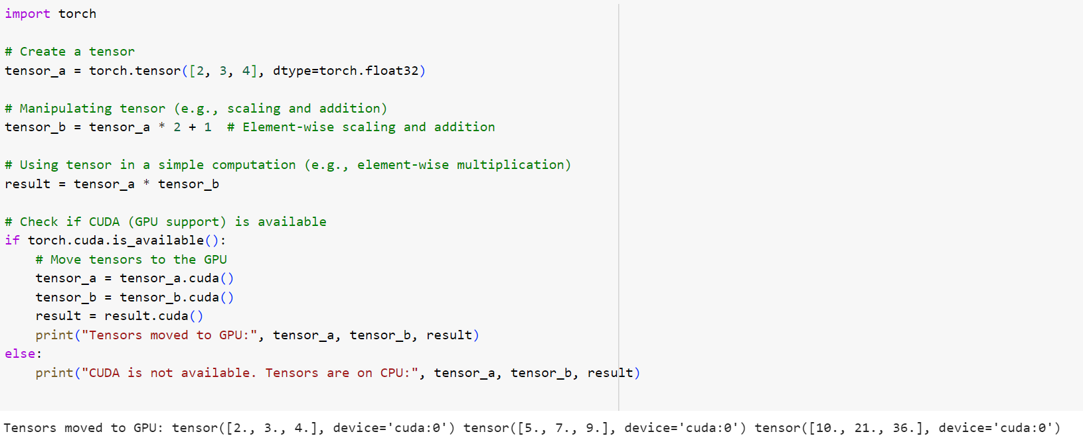
Deep Dive into Tensors
This slide covers how tensors are created, manipulated, and used in PyTorch, with examples showing operations on tensors, and how they can be moved to a GPU for accelerated computing.

Slide 13
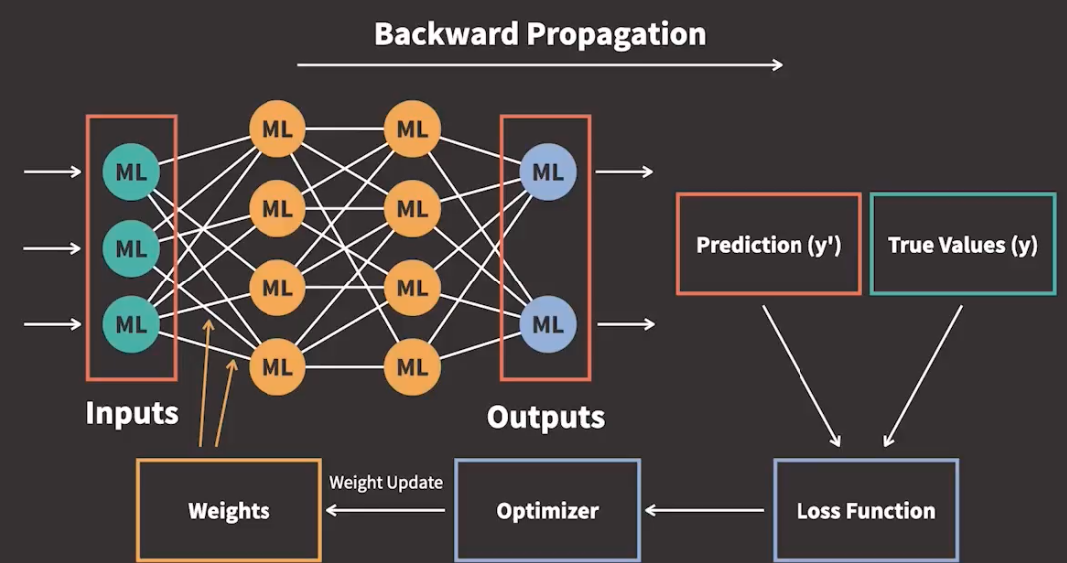
Automatic Differentiation (Autograd)
There are 2 steps in training neural networks,
Forward propagation
Backward propagation
After the loss function is calculated, the derivative of the loss function in terms of the parameters are calculated
Iteratively update the weight parameters accordingly that the loss function returns the smallest possible loss
This is called iterative optimization, as we use an optimizer to perform the update of parameters
This is called gradient based optimization
Autograd is a set of techniques that allows us to compute gradients for arbitrary complex loss functions efficiently

Slide 14
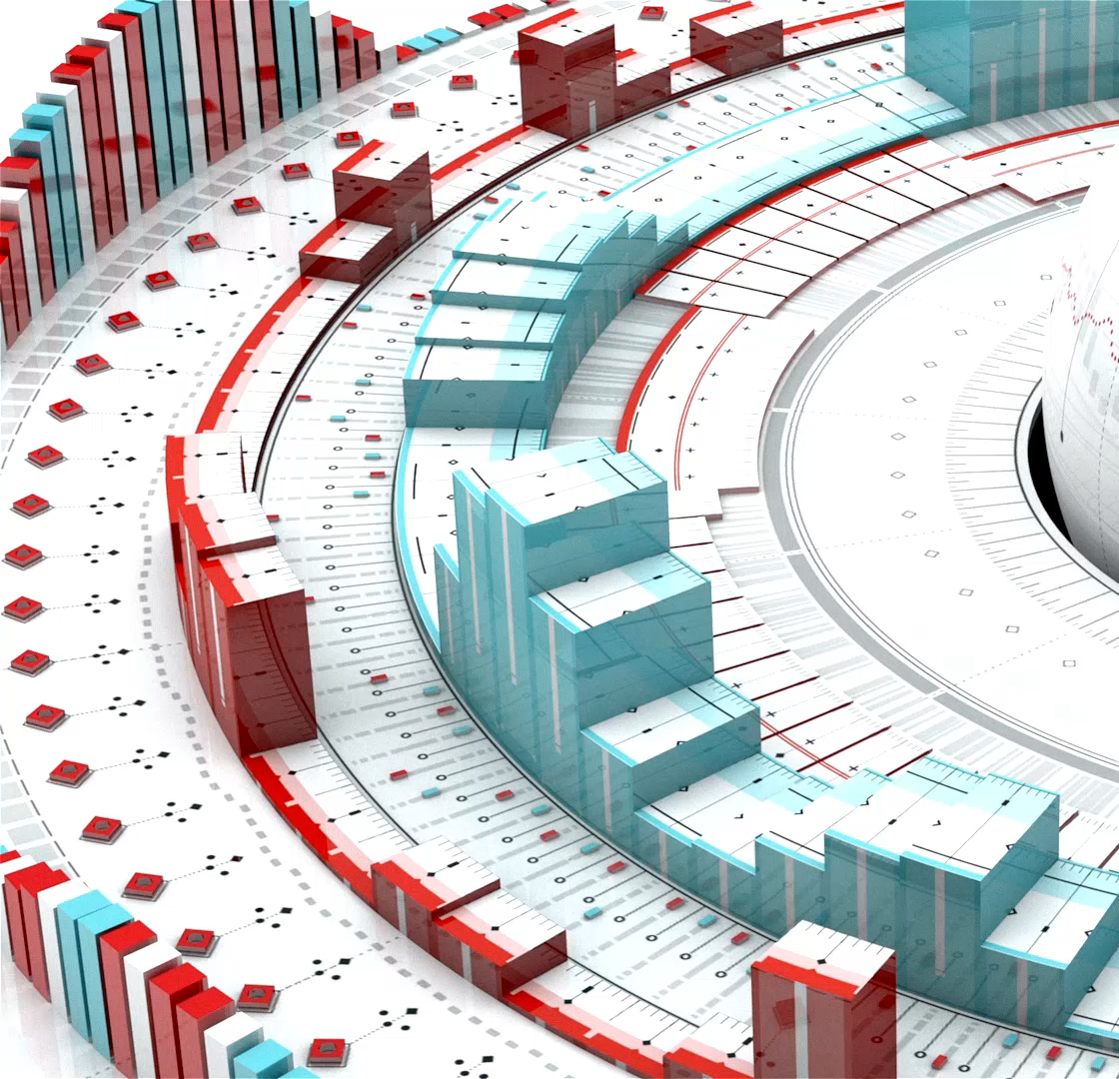
Neural Network Module
PyTorch's nn module is a comprehensive library that includes a wide range of pre-defined layers, loss functions, and utilities that are essential for building neural networks. It provides an easy way to construct network architectures, enabling both the simple assembly of standard layers like convolutional and linear layers, and the customization of more complex models. This module greatly simplifies the process of defining a network's forward pass, with its intuitive and Pythonic approach, allowing for clear and readable code that closely resembles the actual architecture of the model.

Slide 15
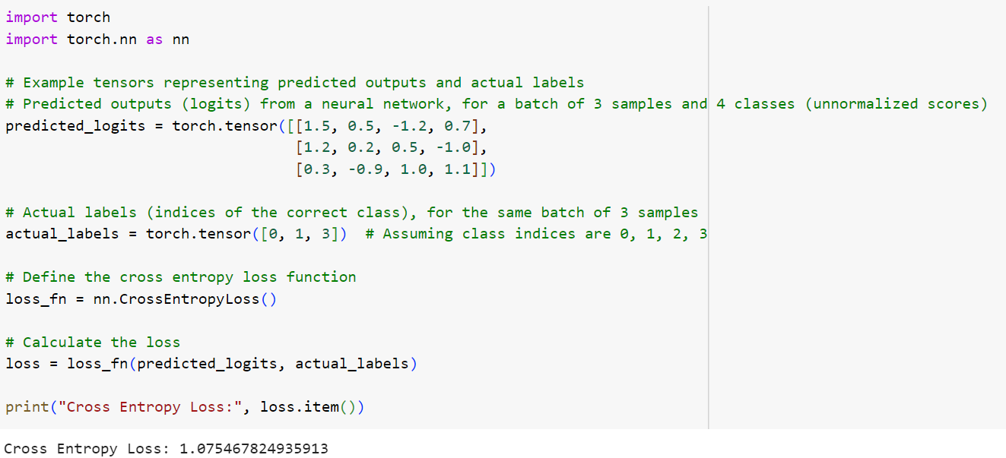
Optimizers and Loss Functions
PyTorch offers various optimizers like SGD (Stochastic Gradient Descent), Adam, and RMSprop, each providing different approaches to navigating the loss landscape.
Key loss functions include CrossEntropyLoss, used for classification tasks, and Mean Squared Error (MSE), commonly used in regression.
These functions measure the difference between the predicted output and actual data, guiding the model's improvements during training.

Slide 16
DL Training Process
Data preparation
Converts generic data (text, image, video, audio etc.) to numerical values, in the form of tensors. Tensors are pre-processed during transforms and then group them into batches before passed into the model
Model Development
It involves model design, training and testing performance
Dataset is divided into training data, validation data and testing data
Model Deployment
Save the model to a file
Deploy the model to a product or service (usually on a cloud server or to an edge device)

Slide 17
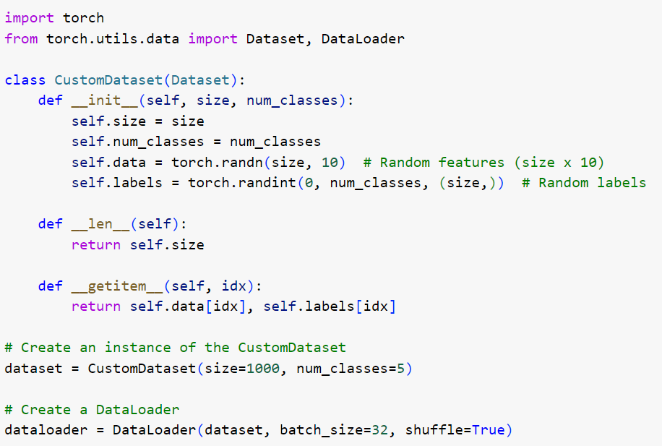
Data Handling in PyTorch
PyTorch's Dataset and DataLoader classes streamline data preprocessing and loading. Dataset allows for custom data handling, while DataLoader efficiently batches and loads data, offering options like shuffling and multiprocessing. For instance, in image classification, DataLoader can automate the process of loading and transforming images into tensor format, ready for model input.

Slide 18
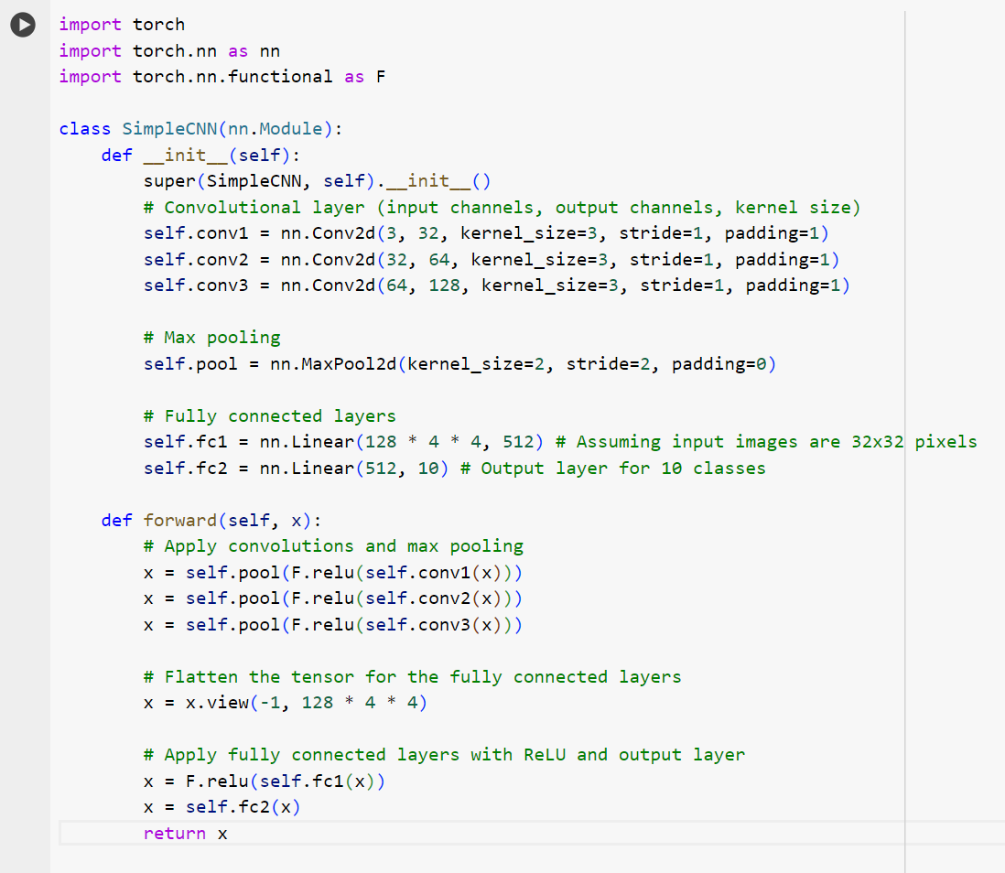
Building a Simple Neural Network
Building a neural network in PyTorch involves defining a model class that inherits from nn.Module. The class typically includes an __init__ function to define layers and a forward function for the data flow. For example, a simple network for image classification might include convolutional layers, activation functions like ReLU, and a final fully connected layer.

Slide 19
Computer Vision with PyTorch
PyTorch's robustness in computer vision comes from its comprehensive libraries like torchvision, which includes pre-trained models, datasets, and image transformation tools. It enables tasks such as image classification, object detection, and segmentation. For example, using a pre-trained ResNet model from torchvision, one can easily implement transfer learning for custom image classification tasks.

Slide 20
Advanced Features in PyTorch
PyTorch's advanced features include support for CUDA, enabling GPU acceleration for faster computation. It also offers distributed training capabilities, essential for handling large datasets and complex models. PyTorch's JIT Compiler improves performance by converting models to optimized TorchScript, and its C++ front-end allows integration with C++ codebases, enhancing flexibility and efficiency in model deployment.

Slide 21

Community and Ecosystem
PyTorch is supported by a strong community of developers and researchers. The PyTorch ecosystem includes extensive documentation, tutorials, and a forum for discussions. Notable contributions come from both academic and industry leaders, ensuring continuous improvements and updates. This robust support system is invaluable for both beginners and advanced users for troubleshooting and keeping abreast of the latest developments in deep learning.

Slide 22

Best Practices in PyTorch
To ensure efficient and effective model training in PyTorch, it's important to follow best practices such as using GPU acceleration where possible, properly splitting data into training and validation sets, and utilizing PyTorch's inbuilt functionalities like DataLoader for data management. Regularly saving and loading models during training prevents data loss and allows for fine-tuning. Keeping code modular and well-documented enhances readability and maintainability.

Slide 23
Conclusion and Key Takeaways
To conclude, PyTorch stands out as a flexible, intuitive, and powerful tool for deep learning, especially in computer vision. Its dynamic nature, strong GPU support, and extensive community make it a top choice for both researchers and industry professionals. As we continue to witness rapid advancements in AI and machine learning, PyTorch is well-positioned to remain at the forefront of innovation.

